Slide 1
Online safety for parents & carers
Elmley Castle C of E First School
March 2025

Slide 2
How Many of these ‘apps’ can you name?

Slide 3
platforms
Messaging/Chat
Social Media
Gaming
Live Streaming

Slide 4
Messaging/chat
Other Popular Messaging/Chat ‘apps’
Yubo – allows users to chat and stream, connecting with people close by
2.7 billion monthly users in over 180 countries makes WhatsApp the most popular messaging app in the world
One billion daily active WhatsApp users
140 billion messages are exchanged on WhatsApp everyday
It’s the most popular messenger in the world.
Wink – Swipe left and right through a bunch of new faces and connect with people all over the world
Viber – Lets you text, call, share photos and video call
Discord – Voice and text chat, designed specifically for gamers
Yolo, Kik & Tellonym are anonymous & do not require a phone number or email to connect
Telegram allows communication with complete strangers and promotes secrecy

Slide 5
Social media
Most popular social media platforms used by children and young people in the UK
YouTube
Instagram
Tiktok
Snapchat
Facebook
Social Media provides children with a platform to engage and communicate with each other and can be accessed through Computers, Tablets, Mobile Phone, Smart TV, Games Consoles and Smart Watches.

Slide 6
Social media considerations
How is the account verified?
What communications methods are available?
Does the platform enable location sharing?
How do I adjust the ‘Privacy Setting’ & what are they set to by default?
Does my child know the difference between ‘online’ & ‘real life’ friends?

Slide 7
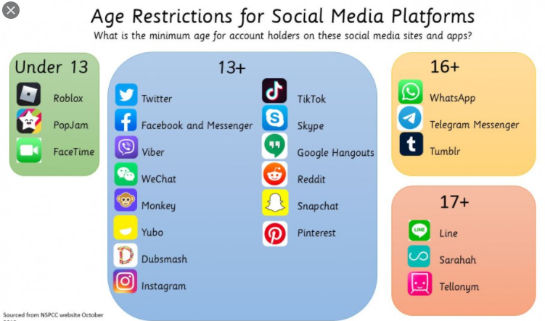
(From April 2024, it’s now 13)
18+ or 13 with parent’s permission
YouTube, WeChat, Kik, Flickr, Play Store and Spotify (12 with parent’s permission)

Slide 8
January 2025
(From April 2024, it’s now 13)
18+ or 13 with parent’s permission
YouTube, WeChat, Kik, Flickr, Play Store and Spotify (12 with parent’s permission)
November 2024
30 Most Dangerous Apps for Kids In 2024 | Unsafe Social Media
https://safelagoon.com/en/blog/insights/30-most-dangerous-apps-for-kids-in-2024/

Slide 9
gaming
Why Do People ‘Game’?
Fun/Entertainment/Relax
Escapism/Autonomy
Social Interaction/Belonging
FOMO (Fear Of Missing Out)
Compete/Competence
Addiction/Disorder
Groom/Exploit
93% of children in the UK play computer games
66% of 8-12 year olds play computer games for 2 hours or more per day

Slide 10
Gaming considerations
CONTENT…
Is the content within the game suitable for your child?
Is the content impacting on their behaviour/interactions?
COMMUNICATION…
Who are they communicating with whilst playing?
How are they communicating?
What information is visible?
What are the ‘Privacy Settings’ set to?
Check cards linked to platforms or games are password protected

Slide 11
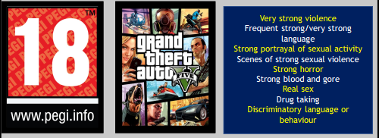
PEGI ratings
Pan European Game Information (PEGI) is a European video game content rating system based upon age appropriateness of games
86% of British parents and carers ignore the age-ratings on games, compared to 23% on films

Slide 12
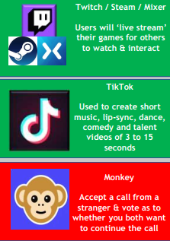
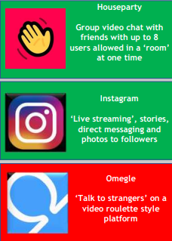
Live streaming
Popular ‘Live Streaming’ Platforms
Many social media apps support ‘live streaming’ which is a popular way to communicate with friends and may include participating in ‘challenges’ or tasks which may help raise awareness of particular social issues or promote positivity.

Slide 13
Live streaming considerations
What personal information is being shared in the background including details about your family or location?
Assess risk and what could go wrong prior to starting the ‘live stream’
There is no opportunity to edit a ‘live stream’ and so consider the impact this could have
You cannot always control who views the content or who might be recording the stream
If ‘live streaming’ risk taking or criminal behaviour, this could have consequences that may last a long time

Slide 14
Risks/behaviours

Slide 15
Risks/behaviours
Risk may be present as a result of the child’s own behaviour or the behaviour of others…
Parents/Carers will often focus on the platform, rather than recognising that it is behaviour that poses the risk to children online.

Slide 16
Risks may be present as a result of…
The behaviour of others
The child’s own behaviour
Sharing personal information/location
‘Sexting’ – Sending inappropriate images of themselves
Cyberbullying
Gaming Addition
Engaging with ‘fake accounts’
Accessing inappropriate content (Pornography)
Engaging in harmful online challenges
Creating or sharing false information/fake news
Seeking recognition from others
Engaging in inappropriate communication with a child
Deliberately exposing a child to inappropriate/illegal content
Cyberbullying
Creating false online content which deliberately misleads
Grooming
Sexual exploitation
Criminal exploitation
Radicalisation

Slide 17
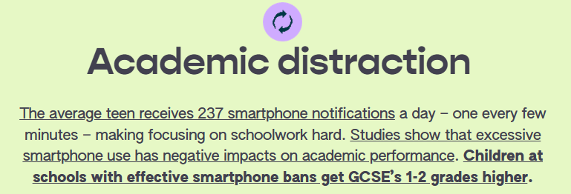
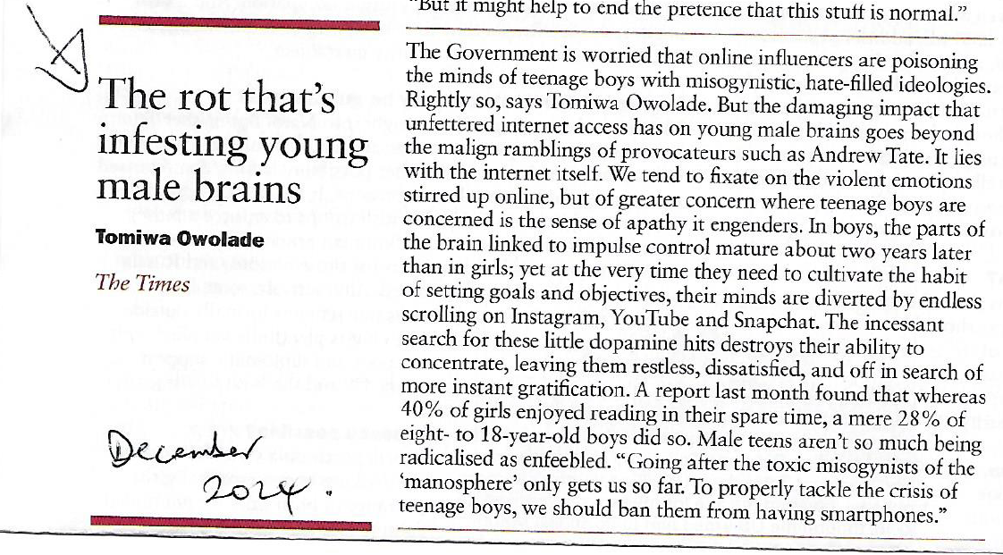
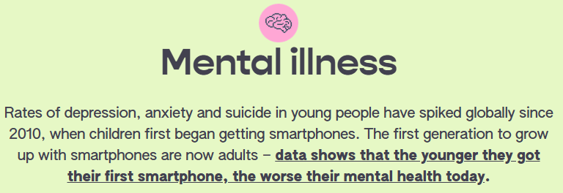
Risks may be present as a result of…
The behaviour of others
The child’s own behaviour
Sharing personal information/location
‘Sexting’ – Sending inappropriate images of themselves
Cyberbullying
Gaming Addition
Engaging with ‘fake accounts’
Accessing inappropriate content (Pornography)
Engaging in harmful online challenges
Creating or sharing false information/fake news
Seeking recognition from others
Engaging in inappropriate communication with a child
Deliberately exposing a child to inappropriate/illegal content
Cyberbullying
Creating false online content which deliberately misleads
Grooming
Sexual exploitation
Criminal exploitation
Radicalisation

Slide 18
Sharing personal information
Keep it locked…

Slide 19
Gaming addiction
Initial Exposure
An individual’s early experiences with gaming, during which enjoyment of and perhaps a fascination with such games may develop very quickly
Deeper Interest
Gaming begins to take up a position of greater significance, perhaps requiring growing investment in hardware, software and time. Other activities may take on a diminished significance in consequence
Full-blown Addiction
Gaming becomes the individual’s dominant or even sole interest. All their free time is taken up with gaming, and all their energies are focused upon it, possibly at the cost of academic progress. Dietary and sleeping patterns are likely to be hugely affected by constant gaming and thgamer may find themselves entirely dislocated from friends, family and the real world
Growing Obsession
Gaming begins to take up a central role in the individual’s life, with their thoughts becoming increasingly solely directed towards gaming. Relationships becoming increasingly neglected as the great majority of free time is now taken up with gaming
The following information is from the World Health Organisation

Slide 20
Social media ‘likes’
Whether it be an achievement, a place they have visited, a new purchase or just what they had for dinner, the need for ‘likes’ (affirmation) can be an addiction and studies show that the more ‘likes’ you get, the better you feel.
Children will regularly post content seeking approval of peers and in search of positive ‘likes’ and comments

Slide 21
Cyberbullying
Making Hurtful Comments – Trolling, Flaming, Roasting, Dissing, Harrassment
Blocking or deliberately killing within a gaming platform – Griefing, Aired
Maliciously posting details about someone’s personal life – Doxing
Stalking someone online – Cyberstalking
Disclosing someone’s sexuality or gender identity online - Outing
It is important to understand the terms used to describe cyberbullying
It’s easy to forget that there is a person behind the screen

Slide 22
The behaviour of others
Radicalisation
Creating false online content which deliberately misleads
Sending inappropriate images of themselves or others
Sexual Exploitation
Cyberbullying
Criminal Exploitation
Deliberately exposing a child to inappropriate/illegal content
Grooming

Slide 23
Responding to concerns

Slide 24
Responding to concerns
Observation
A Disclosure
Peers
A Third Party
Secretiveness, Behaviour (violent/sexualised), Mood Swings, Isolation, Emotional, General Converstaion
Child discloses that they are experiencing negative behaviours online or as a result of online engagement
What are the signs?
Is there any risk of immediate harm?
What’s the child’s view?
What support do they require?
Is there any evidence (Screenshots)?
Peers share concerns about a child’s online experiences
You notice a change in peer group relationships
Parent/Carer of another child may approach you with concerns or present evidence
A professional may share information

Slide 25
What Are The Signs?
No signs
Being secretive about their online activities – spending more or less time than usual online
Being upset after using their phone, laptop or tablet
Becoming increasingly withdrawn, upset or angry
Not wanting to go to school
Avoiding social situations
Impact on mental health

Slide 26
Engaging with your child
Stay Calm
Reassure
Assess the Risk
Report/Refer
Access Support

Slide 27
Reporting online behaviour
CEOP (Child Exploitation Online Protection Command)
Children, Parents/Carers can report inappropriate behaviour through to CEOP
CEOP is a law enforcement agency and is here to keep children and young people safe from sexual exploitation and abuse
CEOP will review and respond to every online report of abuse

Slide 28
Who and where to report
Online Grooming & Child Exploitation
📌 NSPCC / Childline 🔗 Reporting online safety concerns | NSPCC 📞 Call: 0808 800 5000 (Confidential help for parents & guardians).
📌 Internet Watch Foundation (IWF) 🔗 Report online child sexual abuse imagery or 'child pornography’
Report illegal images or videos of children online.
📌 Local Police 📞 Call 101 (Non-emergency) or 999 (Immediate danger).
Scams & Online Fraud (Targeting Kids or Parents)
📌 Action Fraud (UK's National Fraud & Cyber Crime Reporting Centre) 🔗 Report a scam to Action Fraud | Action Fraud 📞 Call: 0300 123 2040 (Mon-Fri, 8am-8pm).
📌 National Cyber Security Centre (NCSC) 🔗 Report a scam email - NCSC.GOV.UK
📧 Forward scam emails to report@phishing.gov.uk
📌 Take Five to Stop Fraud 🔗 Fraud Prevention Advice
How to recognise and avoid online scams.
Cyberbullying & Social Media Issues
📌 Childline 🔗 Report Cyberbullying 📞 Call: 0800 1111 (Confidential, for kids & teens).
📌 Each Social Media Platform:
Instagram: Report Abuse
Snapchat: Report Safety Concern
TikTok: Report Harmful Content
Facebook: Report Bullying
📌 UK Safer Internet Centre 🔗 Report Harmful Content
Help with cyberbullying, harassment, violent content, etc.
Viruses, Malware & Suspicious Apps
📌 National Cyber Security Centre (NCSC) 🔗 Report Malware
If a child’s device is infected with malware or spyware.
📌 Google Play Store (Android) 🔗 Report Harmful Apps
📌 Apple (iPhone/iPad) 🔗 Report a Problem with an App
📌 Your Internet Provider (BT, Virgin, Sky, etc.)
Most providers offer free parental controls & virus protection.

Slide 29
What should be reported
Someone online is putting pressure on me to do things I don’t want to do
Someone I don’t know is asking me to live-stream & do things I don’t want to do
Someone online keeps asking me to meet them face-to-face & I feel pressured by them
Someone I met in an online game keeps trying to talk to me privately

Slide 30
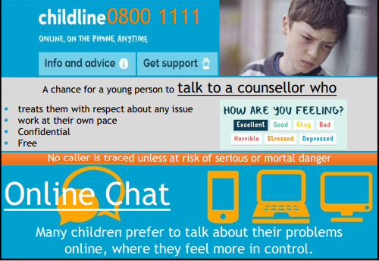
Support - childline

Slide 31
Making things ‘safer’

Slide 32
Making things ‘safer’
There are a number of websites, ‘apps’ and support lines available to parents/carers and children to make the online world a safer place.
Important to remember that this support may make things ‘safer’, but they cannot make it completely ‘safe’
It is still incredibly important to ‘research content’, ‘monitor activity’ and ‘promote yourself’
Family Contract Agreement for Online Activity
Advice for Children when setting profiles
Support for Children & Parents/Carers
Monitoring Online Activity
Keeping Younger Children Safe

Slide 33
Family contract
Family Contract Agreements are a great way of promoting safer internet use
It is important that YOU set an example

Slide 34
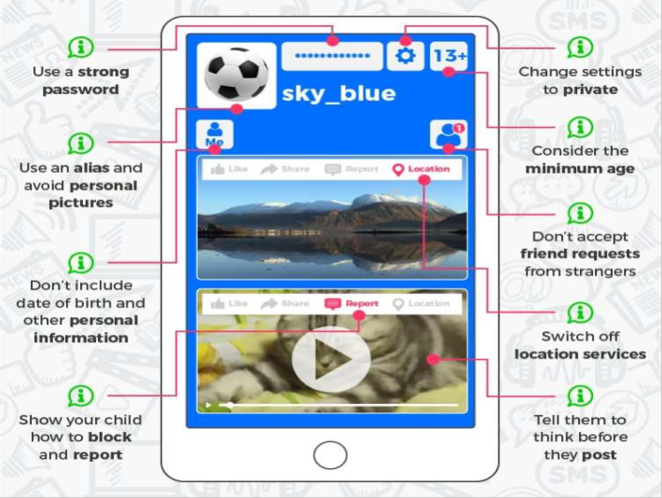
‘safer’ profile advice

Slide 35
Monitoring Online Activity

Slide 36
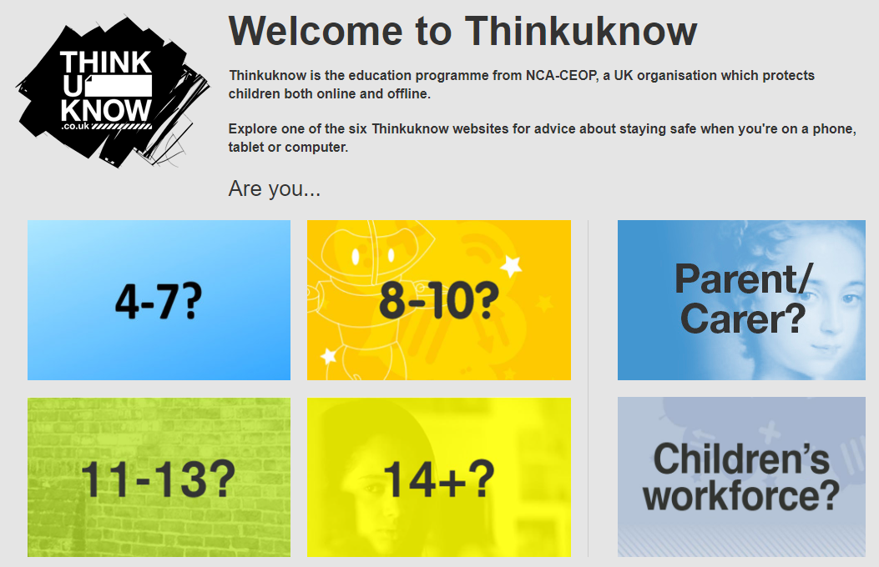
Support for Children & Parents/Carers

Slide 37
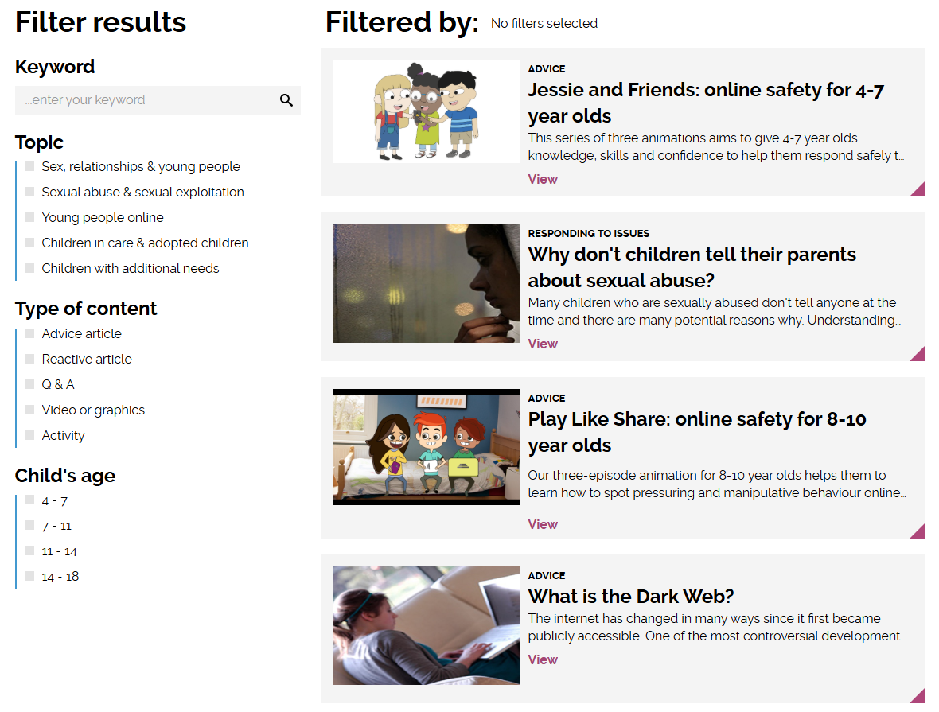
Parents and carers | CEOP Education
https://www.ceopeducation.co.uk/parents/

Slide 38
KIDSONLINEWORLD
www.kidsonlineworld.com

Slide 39
What are the positives to your child having a smart phone?
Safety and Communication
Emergency Contact: Kids can quickly reach parents or emergency services if needed.
GPS Tracking: Parents can monitor their child’s location for safety.
Instant Messaging and calls: Easier to stay in touch when away from home.
Educational Benefits
Access to Learning Apps: Education apps help with homework, language learning and skill development.
Research and Information: Quick access to the internet for school projects.
Reading and Audiobooks: Encourages reading through apps like Kindle or Audible.
Social and Emotional Development
Staying connected: Helps kids maintain friendships through calls, text and social media.
Develops Digital Skills: Prepares them for a tech-driven world.
Entertainment and Creativity: Engages them in photography, music and creative apps.
Convenience and Independence
Mobile Payment: Allows kids to use digital wallets instead of chats.
Transportation Apps: Helps with navigation or public transport.
Smart Home Connectivity: Can help manage home devices, like alarms or lights.
Time Management and Responsibility
Calendar and reminders: Helps with organisation and time management.
Teaches Responsibilities: Encourages responsible phone use and self-discipline.

Slide 40
Smartphone Free Childhood
https://smartphonefreechildhood.co.uk/
Founded in February 2024
A community of over 150,000 parents nationwide
Actively encouraged by Bredon Hill Academy
WhatsApp support groups for parents
Strategies to reduce the “Fear of Missing Out” amongst your child

Slide 41
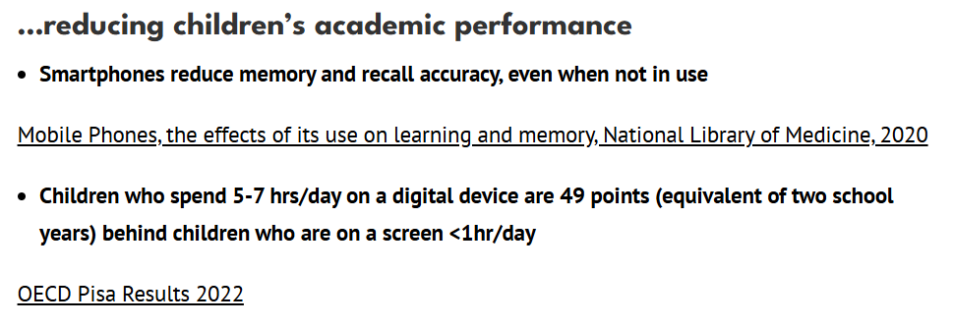
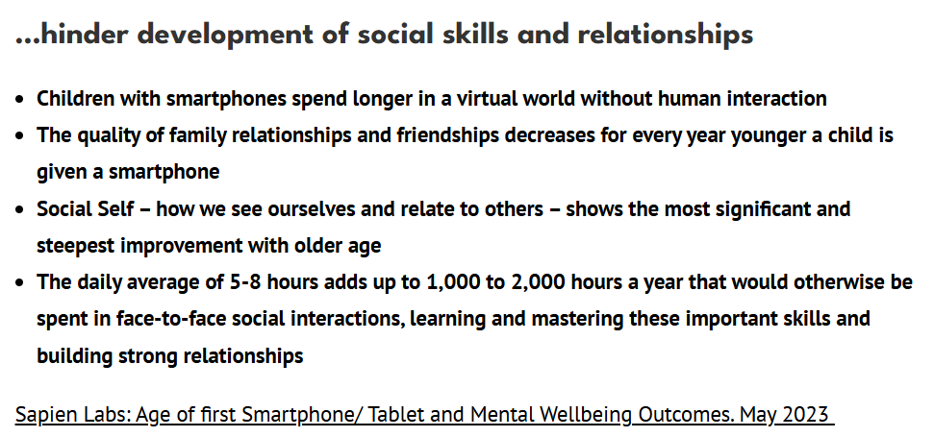
https://delaysmartphones.org.uk/evidence/

Slide 42
Links to statistics used in presentation (from Smartphone Free Childhood) :
2023-cs-smartphone-research-report_final-for-web.pdf
The effects of smartphone addiction on learning: A meta-analysis - ScienceDirect
https://policyexchange.org.uk/wp-content/uploads/Disconnect.pdf
Sapien-Labs-Age-of-First-Smartphone-and-Mental-Wellbeing-Outcomes.pdf

